Slide 1
Compiler Design

Slide 2
Syllabus
https://grupoantolin-my.sharepoint.com/personal/sunil_patil_grupoantolin_com/Documents/Desktop/jyoti/college%20data/Compiler%20design.docx

Slide 3
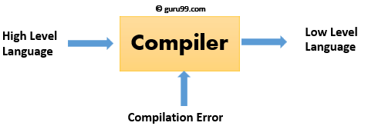
What is a Compiler?

Slide 4
Features of Compilers
Correctness
Speed of compilation
Preserve the correct the meaning of the code
The speed of the target code
Recognize legal and illegal program constructs
Good error reporting/handling
Code debugging help

Slide 5
Types of Compiler
Following are the different types of Compiler:
Single Pass Compilers
Two Pass Compilers
Multipass Compilers

Slide 6
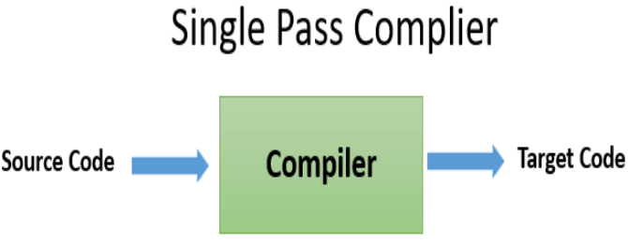
Single Pass Compiler

Slide 7
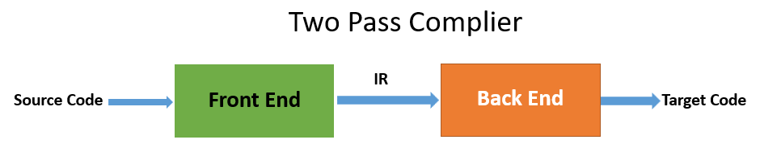
Two Pass Compiler

Slide 8
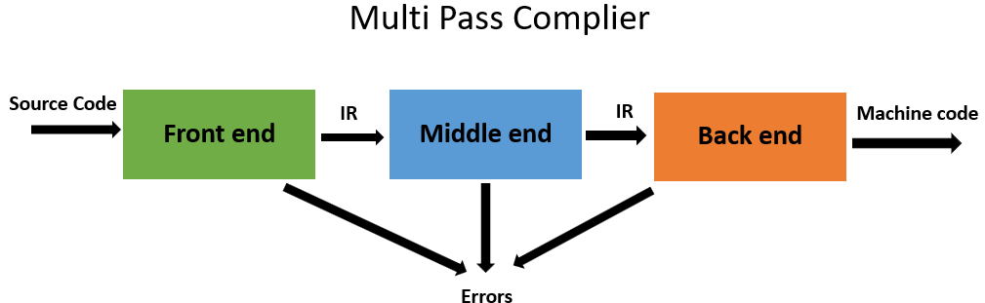
Multipass Compilers

Slide 9
Tasks of Compiler
Breaks up the up the source program into pieces and impose grammatical structure on them
Allows you to construct the desired target program from the intermediate representation and also create the symbol table
Compiles source code and detects errors in it
Manage storage of all variables and codes.
Support for separate compilation
Read, analyze the entire program, and translate to semantically equivalent
Translating the source code into object code depending upon the type of machine

Slide 10
History of Compiler
The "compiler" word was first used in the early 1950s by Grace Murray Hopper
The first compiler was build by John Backum and his group between 1954 and 1957 at IBM
COBOL was the first programming language which was compiled on multiple platforms in 1960
The study of the scanning and parsing issues were pursued in the 1960s and 1970s to provide a complete solution

Slide 11
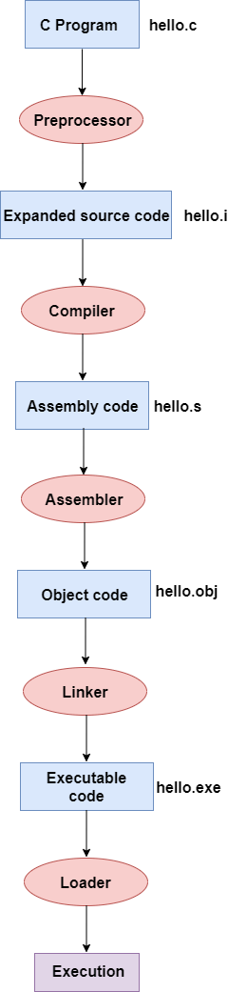
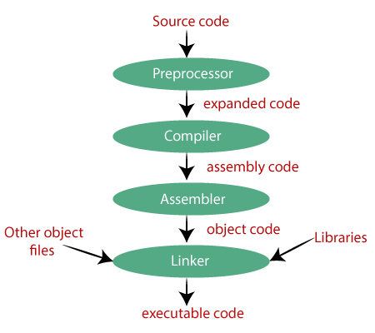
Steps for Language processing systems EXAMPLE
Compilation process in c

Slide 12
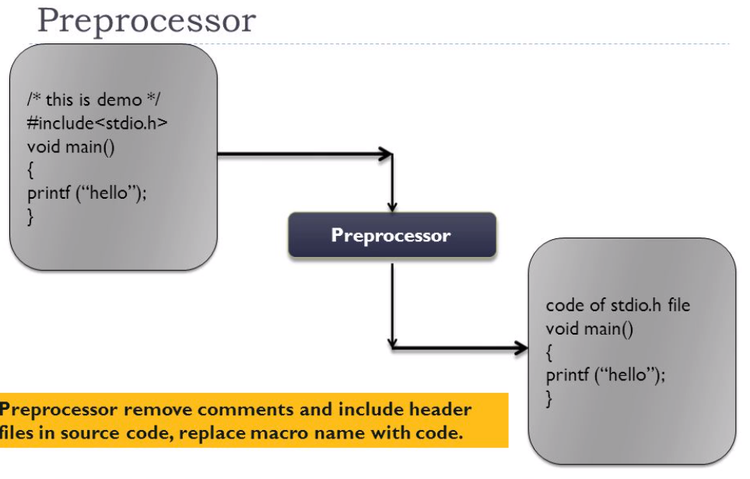

Slide 13
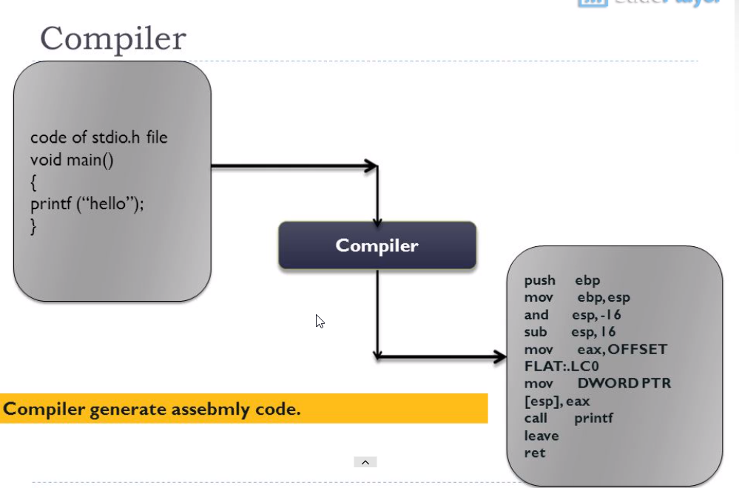

Slide 14
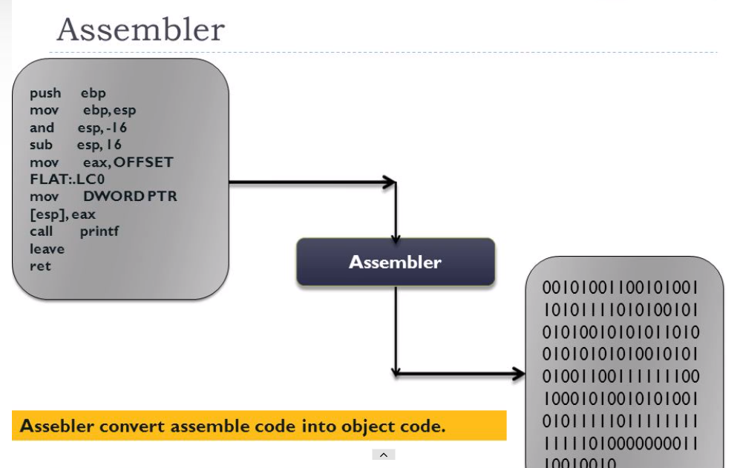

Slide 15
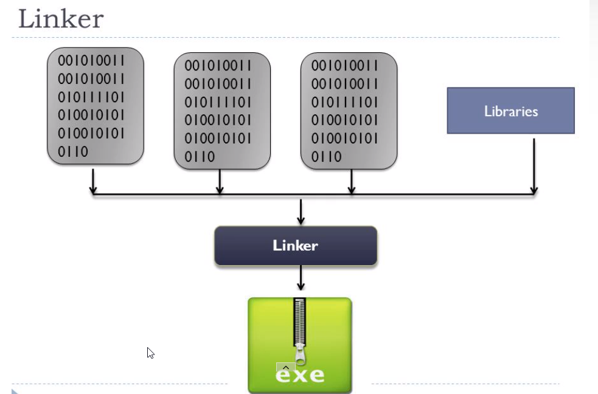

Slide 16
Why use a Compiler?
Compiler verifies entire program, so there are no syntax or semantic errors
The executable file is optimized by the compiler, so it is executes faster
There is no need to execute the program on the same machine it was built
Translate entire program in other language
Check for syntax errors and data types

Slide 17
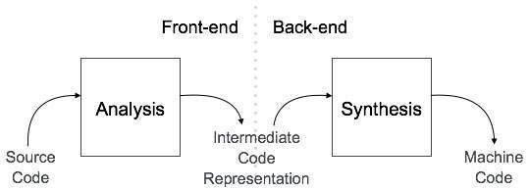
The compiler design architecture

